Slide 1
Straight Talk on
Matthew 5:27-30
Dr. Rick Griffith, Crossroads International Church
www.BibleStudyDownloads.org

Slide 2
1967
Notes:
The year was 1967, and a nine-year-old boy rummaged around in his stepfather's desk with his two friends.
• To their surprise, several Playboy magazines lay in the top drawer. Having never seen such things before, they boys looked with curiosity. However, when they went back a few days later, they found the drawer locked. In fact, I had a difficult time getting any other pornography. Playboy was also unavailable at the corner market—out of sight behind the counter and available for sale only to adults.

Slide 3
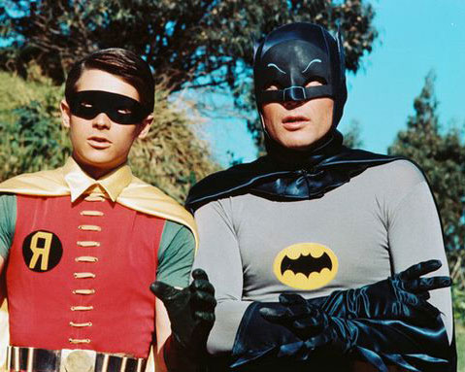
1960s TV
Notes:
At that time, no explicit images appeared in movie theatres or TV, nor was there such a thing as home entertainment as videos, CDs, and DVDs were not yet invented.

Slide 4
Deadpool
Notes:
Not so today! Sexually explicit images are readily available everywhere: internet porn, DVDs, even the present Deadpool movie broke all box-office records last week for an R-rated film filled with sexually explicit images.

Slide 5
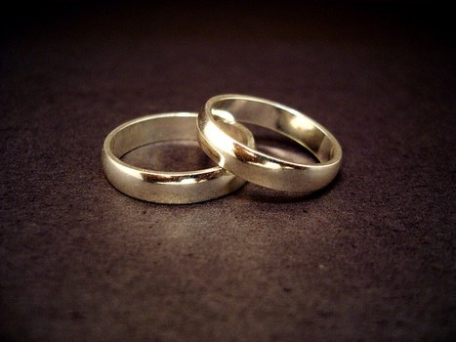
Marriage
Notes:
The result is a society that devalues sex in marriage.
Marriage itself has been redefined as a relationship where two people love each other, despite being of the same gender.
Are we more sexually fulfilled today? To the contrary, watching explicit images leaves people lonely and unfulfilled.

Slide 6
Adultery
Notes:
How are you doing in this area? Are you winning your battle against sexual immorality—or are you losing the battle?

Slide 7
Different Temptations
Men
Women
Visual
Relational
Images
Romance
• Women seek sex for relationships.
• Men seek relationships for sex.
Notes:
In general, in our fallen state…
• Women seek sex for relationships.
• Men seek relationships for sex.

Slide 8
Relationships for Singles
Notes:
Singles must win against fornication.
This week the Sacramento Bee announced that single adults in California now outnumber married adults. Why? People have given up on marriage.
As a single, are you keeping yourself pure until marriage?

Slide 9
Adultery
Notes:
Those married must win against adultery.
Having the advantage of sex in marriage obviously does not lead to people sexual purity. Many men who visit prostitutes are married men!
A huge number of men commit adultery—from 20% to 65% I've read.
As a married person, are you guarding the purity of your marriage?

Slide 10
How can you guard yourself from sexual sin?

Slide 11
The Sermon on the Mount
A Heart Issue
Notes:
The listeners to Jesus in his Sermon on the Mount were primarily married, but what Jesus said about sexual sin actually relates to all of us.
By the time we get to today's text, Jesus has just begun his specific attacks on the Pharisees. He first spoke about relational harmony in verses 21-26.

Slide 12
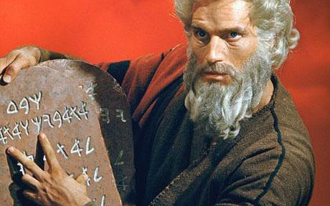
Inscribed by God's hand
Notes:
Now, after telling us how to get along with others, he turns to even the absolutely most personal issue for each of us—the most important relationship in our lives with our spouse.

Slide 13
How can you guard yourself from sexual sin?
Two ways…
Matthew 5:27-30
Notes:
Today we'll see two ways Jesus said you should guard yourself from sexual sin

Slide 14
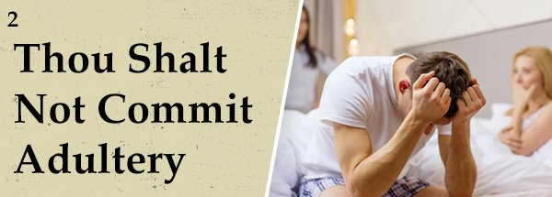
"You have heard the commandment that says, 'You must not commit adultery'" (5:27 NLT).
"Thou shalt not commit adultery"

Slide 15
"But I say, anyone who even looks at a woman with lust has already committed adultery with her in his heart" (5:28 NLT).

Slide 16
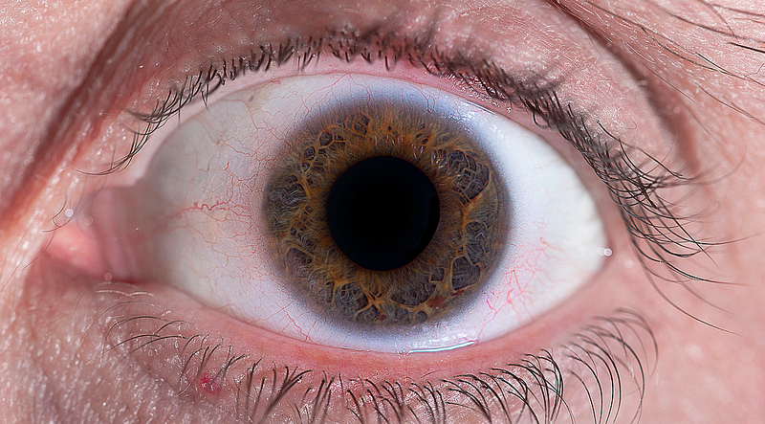
"So if your eye—even your good eye—causes you to lust, gouge it out and throw it away. It is better for you to lose one part of your body than for your whole body to be thrown into hell" (5:29 NLT).

Slide 17
"And if your right hand causes you to sin, cut it off and throw it away. It is better for you to lose one part of your body than for your whole body to go into hell" (5:30 NIV).

Slide 18
How can you guard yourself from sexual sin?
Two ways…
Matthew 5:27-30
Notes:
What's the first way to guard from sexual sin?

Slide 19
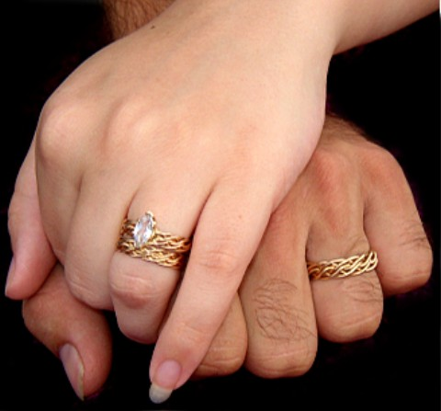
I. Commit to sexual purity (5:27).
Notes:
Promise your body to God for sex only within marriage.

Slide 20
"You have heard the commandment that says, 'You must not commit adultery'" (5:27 NLT).
"Thou shalt not commit adultery"
Notes:
Jesus' hearers knew the seventh commandment (5:27a)

Slide 21
What is adultery?
Notes:
Adultery is voluntary sexual intercourse with a married person who is not one's spouse. God has our greatest joy in mind, so he calls adultery sin.
Technically, two single people cannot commit adultery, as adultery is possible only if one person is married. Sex between singles is also sin but it is called fornication.

Slide 22
Why do people commit adultery?
Notes:
Many reasons—but one1631 edition of the Bible commands adultery. Seriously…

Slide 23
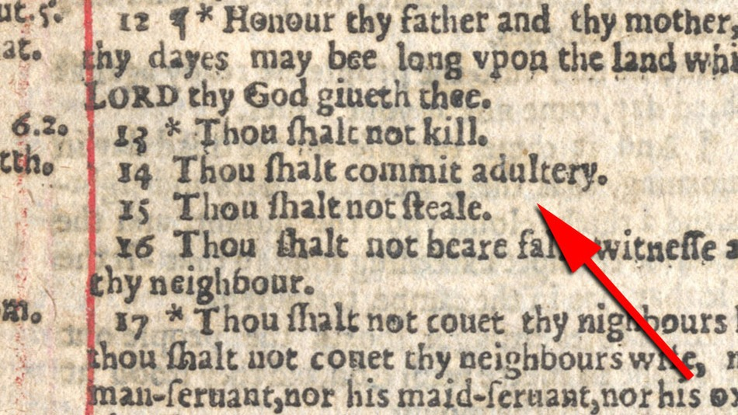
"Thou shalt commit adultery"
Notes:
An Unfortunate Omission Means the Seventh Commandment Reads: 'Thou Shalt Commit Adultery'
(AP)
The "Sinner's Bible," a 400-year-old Bible containing a typo in the Ten Commandments and encouraging individuals to have affairs, is up for sale, The Independent reports. Published in 1631 by Robert Barker and Martin Lucas, the royal printers, the Seventh Commandment contains an unfortunate omission and reads: "Thou shalt commit adultery."
The Independent reports that the mistake was discovered one year after 1,000 copies were printed; however, King Charles I was outraged that such a brazen mistake had been made and ordered the books to be withdrawn and burned. … It is said that nine copies of the book survived King Charles' order, making them extremely rare. The Daily Mail expects that the Bible will sell for £15,000 at an auction on November 11 at Bonhams in London.
________
By Loren Gutentag | Wednesday, 21 Oct 2015 11:19 AM
Accessed 19 Feb 2016

Slide 24
Adultery
Affair
Fling
Notes:
Adultery is seen as exciting and glamorous now.
Look at our change of vocabulary. Instead of calling it the horror that it is, we call adultery an "affair" (sounds like "flair"), a "fling" (sounds like "swing"), or any other title that obscures the fact that…

Slide 25
"You shall not commit adultery"
Notes:
…adultery takes a hammer to the vows that provide security in marriage.

Slide 26
Watch Your Eyes
Notes:
One website even exists to aid people in adultery.

Slide 27
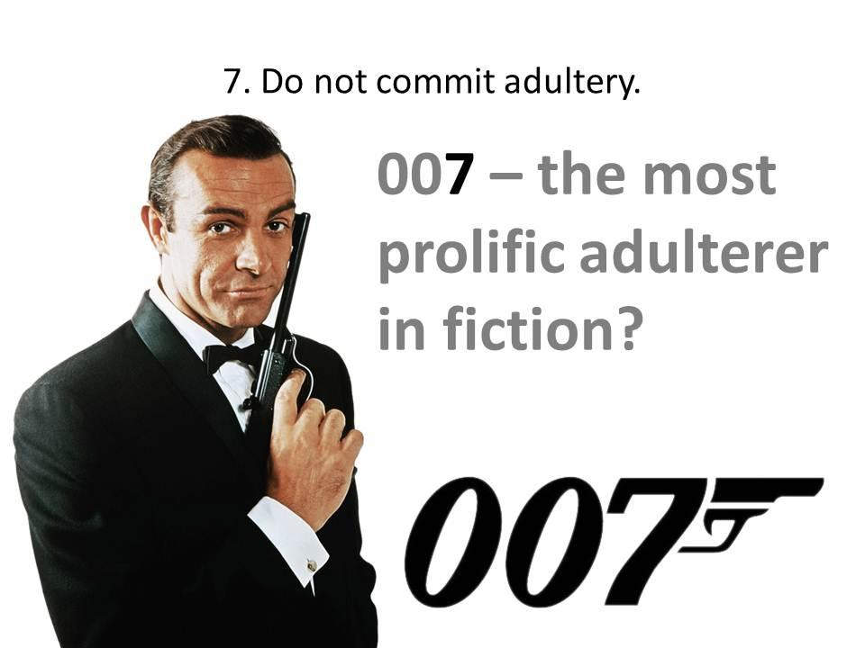
7—"Do not commit adultery."
007 — The most prolific adulterer in fiction
Notes:
James Bond 007 epitomizes the so-called glamour of adultery. Interesting, isn't, that his number is the "perfect number 7" in Scripture—which is also the 7th of the Ten Commandments?

Slide 28
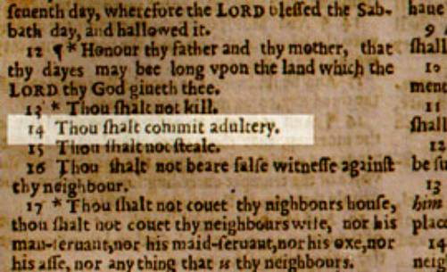
"Thou shalt commit adultery"
Notes:
God prohibited adultery in this command (5:27b)

Slide 29
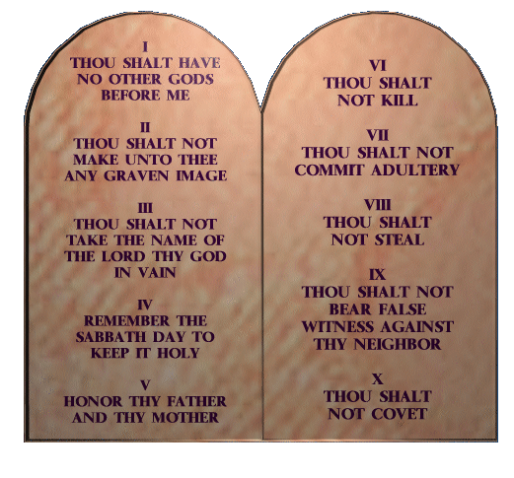
The Seventh
Notes:
This was the seventh commandment. Speaking of murder just before this—the sixth commandment—now he just goes to the next one relating to marriage.
In reality, adultery breaks all of the Ten Commandments:
1. Adultery has a god called sex before the true God.
2. Adultery worships the image of unlawful sex.
3. Adultery dishonors God's name.
4. Adultery typically lasts beyond a week and thus goes over a Sabbath to dishonor that day.
5.Adultery certainly does not honor one's parents.
6. Adultery kills marriage and leads to literal murder.
7. Adultery is explicitly forbidden in commandment 7.
8. Adultery steals from another person.
9. Adultery always has lying to cover it.
10. Adultery obviously covets someone else's wife!

Slide 30
Will you make (or reconfirm) the vow?
Notes:
One of the most important decisions I have ever made was to keep sex within marriage. By God's grace, just making that vow at age 19 enabled me to keep it until I married just before age 26 and has kept me for 32 years of marriage now.

Slide 31
Aim for the target!
Notes:
The problem with many of us is that we never hit the target because we never vow to aim at it

Slide 32
"The grass isn't greener on the other side. It's greener where you water it."
Notes:
As someone has said, "The grass isn't greener on the other side. It's greener where you water it."

Slide 33
"The world is watching to see whether Christians really are different or not." Alistair Begg
Notes:
This includes word to you singles too: Alistair Begg noted, "The world is watching to see whether Christians really are different or not."

Slide 34
Whether single or married, will you commit yourself to purity right now?

Slide 35
How can you guard yourself from sexual sin?
Notes:
So how else can you guard yourself from sexual sin?

Slide 36
I. Commit to sexual purity (5:27).
Notes:
Singles, vow and promise to God now—don't wait until your wedding day as it will be too late!

Slide 37
"There is no higher code" — First Century Jews
The Ten Commandments
Notes:
The Jews had revered the Ten Commandments for a millennium and a half. No one thought of any other code higher than these Ten Laws. Imagine their shock when Jesus started saying that what he had to say was even more important!

Slide 38
II. Guard yourself from lust (5:28-30).
Notes:
Protect your mind from impurity.

Slide 39
Adultery of the heart.

Slide 40
"But I say, anyone who even looks at a woman with lust has already committed adultery with her in his heart" (5:28 NLT).
Notes:
Verse 28 is the heart of these four verses.

Slide 41
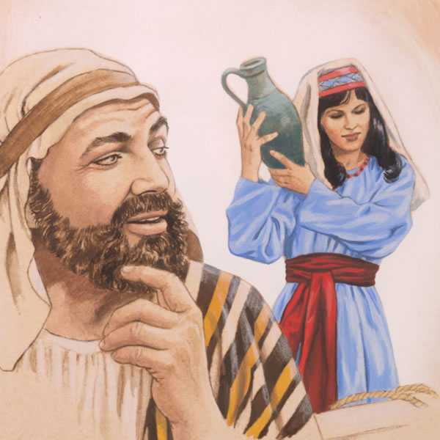
A problem of the mind.
Notes:
Instead of focusing on the outward sin of adultery, Jesus shows us that our basic problem is our mind.
By showing us how to defeat lust, Christ helps us get to the root of sexual sin

Slide 42
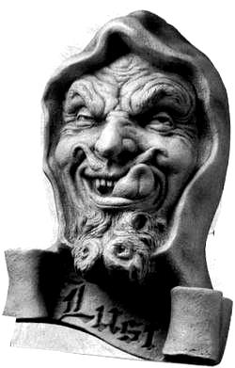
What is lust?
—a wrongful desire for what God forbids
—imagining sex with someone other than your spouse
Notes:
God designed us with legitimate desires for food, water, and even sex…

Slide 43
"…already committed adultery with her in his heart" (5:28b)?
Notes:
Here we must distinguish between temptation and sin. To be tempted to lust is not sin. The tense here does not refer a passing glance that is not pursued.
However, to actually lust is indeed sin, because it means that a man hasn't avoided this sin of the heart and imagination. The present tense participle here "refers to one who continues to look rather than just casting a passing glance" (Blomberg, 109).
Worse yet, the actual act of adultery is worse than the thought of adultery.

Slide 44
As bad as adultery?
Notes:
Jesus calls both lust and adultery sin.
But are all sins the same magnitude? All sins displease God, but not all sins have equal consequences. Adultery destroys marriage because it violates the marriage vow.

Slide 45
Adultery has far greater consequences than lust
Notes:
Yet, in a real sense, lust also violates the marriage vow for a man to commit himself and devote himself only to his wife—but the result of lust certainly is not as severe as the result of adultery.

Slide 46
Guard yourself from lust (5:29-30)

Slide 47
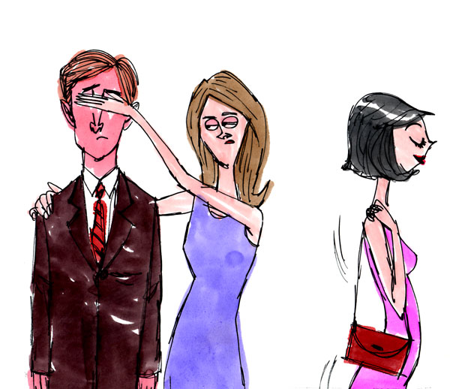
Guard your eyes from lust (5:29).

Slide 48
Why the eye and hand?
Notes:
What is significant about Jesus picking the eye and hand (5:29-30)? Why not the ear and leg?
The eye is the gateway to the imagination. If you watch what you see, you will watch what you think!
What the eye sees affects what the hand does later. Therefore, the hand is particularly important. Our hands can be used for either good or evil purposes.

Slide 49
"So if your eye—even your good eye—causes you to lust, gouge it out and throw it away. It is better for you to lose one part of your body than for your whole body to be thrown into hell" (5:29 NLT).
Notes:
Did Jesus really and literally command us to gouge out our eye and cut off our hand (5:29-30)?
Hmmm, I wonder why we ask if he really meant what he said! Surely he could be exaggerating to make his point!

Slide 50
"And if your right hand causes you to sin, cut it off and throw it away. It is better for you to lose one part of your body than for your whole body to go into hell" (5:30 NIV).
Notes:
But what is that point? He tells us explicitly: If your eye or hand so tempt you to follow your lustful passions instead of trusting Christ to help you get rid of them, you are not trusting Christ for salvation.

Slide 51
TIME TO TURN
BEFORE YOU BURN REPENT
Notes:
Indeed, you don't even want to be saved if you want to fulfill your lustful passions instead of entrusting yourself to Christ, so the result is to enter hell with two eyes and two hands. How tragic!

Slide 52
What is even better than gouging out your eye?

Slide 53
Realize that your eye is the gateway to your mind.

Slide 54
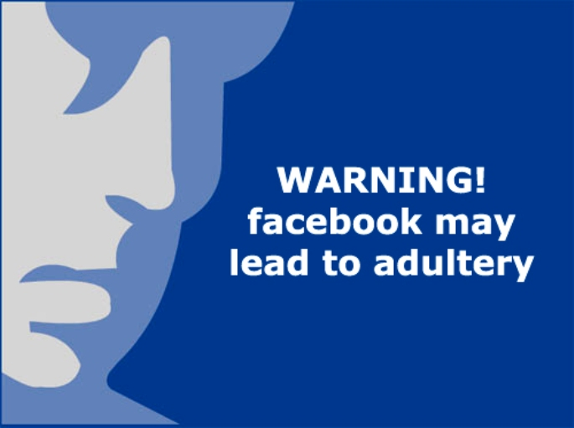
WARNING! facebook may lead to adultery
Notes:
Remove your sources of temptation!

Slide 55
Safeguard your computer and mobile phone!

Slide 56
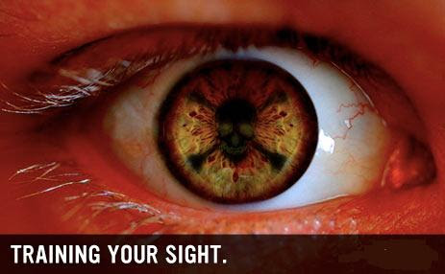
"The eye is the lamp of the body; so then if your eye is clear, your whole body will be full of light" (Matthew 6:22).
Train your eye not to see things that stimulate lust.

Slide 57
Guard your hands from lust (5:30)

Slide 58
"And if your right hand causes you to sin, cut it off and throw it away. It is better for you to lose one part of your body than for your whole body to go into hell" (5:30 NIV).
Notes:
Would a one eyed and one-handed person be guaranteed not to sin?
Obviously not—you can still lust with the left eye and still touch someone inappropriately with the left hand.
Both the right eye and right hand were viewed as more valuable in antiquity, as most people then (as now) were right-handed. So the point is that we must be willing to take severe measures to protect ourselves from sin.

Slide 59
What is even better than cutting off your hand?

Slide 60
Keep it on.
Notes:
Never take off your wedding ring in public. The sign of marriage is on our hand!

Slide 61
"How can a young man keep his way pure? By keeping it according to Your word. With all my heart I have sought You; Do not let me wander from Your commandments" (Psalm 119:9-10).
Replace your sources of temptation with sources of purity.

Slide 62
Hug right.
Notes:
Avoid touching anything or anyone that encourages lust. Hug right—

Slide 63
Avoid the AWKWARD HUG
Notes:
—but not the awkward hug!

Slide 64
How can you guard yourself from sexual sin?

Slide 65
Commit & watch
Main Idea:
Notes:
Vow and guard!

Slide 66
I. Commit to sexual purity (5:27).

Slide 67
II. Guard yourself from lust (5:28-30).
Notes:
If you first don't look, then you won't act.

Slide 68
How can you ladies help us men?

Slide 69
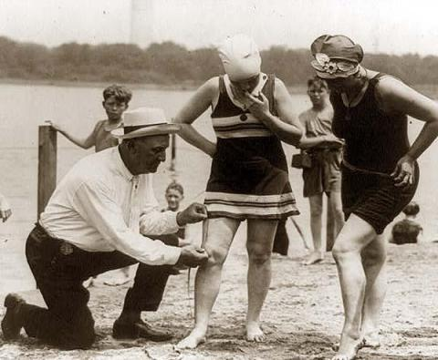
Don't tempt us by what you wear!
Notes:
Watch cleavage

Slide 70
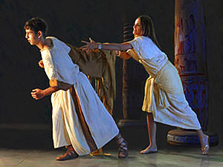
"How could I sin against God?" (Gen. 39:9)
Notes:
Obviously Potiphar's wife was the one to blame, but other women are like her.

Slide 71
How to Quit Porn
Want to quit porn
Do things you haven't done before
Be brutally honest with another person
"Clean house"
Block entry points
Get accountable to a man
Douglas Weiss CovenantEyes.com
Notes:
How to Quit Porn: 6 Essential Steps
Monday, April 23, 2012 | Written by Guest Author
Accessed 19 Feb 2017
The first part to quitting porn is you really have to want to quit porn. You need to be sick and tired of porn and the sickness that it causes you in order to quit. If you are not committed, you will only be quitting until the next time you look. Deep inside you have to want to stop.
Secondly, you have to be willing to do things you haven't done before. Seriously, if you keep quitting the same way, you're likely to fail again. To quit, you have to give up what you've been doing and do what you have to do.
Thirdly, you have to be brutally honest with another person. This person may be a male friend, your wife, a person of clergy, a life coach or a twelve step group person. Somebody has to know the truth about your porn usage for you to get and stay free.
Next, you have to do what I call "clean house." You have to get rid of the porn you have. Throw away the discs, magazines, anything you have used as pornography, and make sure to dump and clean out your computer. This is just a start, some you have to clean house regularly.
The next step is you have to block entry points. This means have a porn blocker and accountability software like Covenant Eyes on your phone, computer at home, and at the office. If you have people sending you compromising emails, block them. Unsubscribe from porn websites. You may have to decide if credit cards are a problem. You know how porn is coming into your life. If you had a gun to your head in a minute you could block entry points.
Finally, get accountable to a man on a daily basis about your porn usage. Make a call a day and a commitment to call this person before you even consider looking at porn. People who set consequences for porn relapse do better. Seriously, if you look at porn, set a consequence. Some guys run laps, give money to the political party they don't vote for, do leg lunges for a half mile, give up some privilege or just pick up trash on the highway for a few hours.
You have to decide that you are worth living porn free. I decided that almost 25 years ago and just passed a polygraph verifying my freedom. I believe you're worth it but your behavior will show you if you are. Don't believe your words. Believe only your behaviors; otherwise, you can be in denial as to your commitment to being porn free.
Remember, you are not the only one being affected if you are married. She is in pain because of your porn usage. Your children are being affected as well. They deserve the best man you can be. You decide. Do they get the porn-drunk you or the porn-free you? I recommend the porn-free you. It's the better you.
Photo credit: um_gngama
. . . .
Douglas Weiss, Ph.D. is a nationally known author, speaker and licensed psychologist. He has appeared on many national talk shows including Oprah, Dr. Phil, Good Morning America and 20/20. Dr. Weiss travels the country training professionals in the treatment of marriage, sexual addiction, and sexual abuse. Dr. Weiss is currently the executive director of Heart to Heart Counseling Center where his staff offers 3-Day Intensives and Telephone Counseling in his Colorado Springs, Colorado office.

Slide 72
"What's the big deal? All men look at porn. It is perfectly normal. Well, most men look at porn. This is normal."

Slide 73
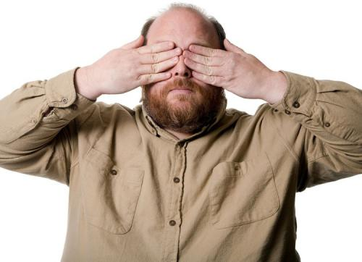
"Flee [sexual] immorality. Every other sin that a man commits is outside the body, but the immoral man sins against his own body" (1 Cor. 6:18 ).

Slide 74
"I made a covenant with my eyes not to look with lust at a young woman"
Job 31:1 NLT

Slide 75
SIGN UP FOR COVENANT EYES SOFTWARE

Slide 76
Covenant Eyes

Slide 77
Christian Accountability Christ-Centered Questions for Accountability Partners
Notes:
We men need to help each other here.

Slide 78
Covenant Eyes
Notes:
Protect your kids too.

Slide 79
Title
Your Brain on Porn
Notes:
Download this pdf for free.

Slide 80
Resources
Notes:
XXXChurch.com is a free porn addiction accountability program.
Investigate movies with Plugged In to see how many times sexually explicit images appear in a movie.

Slide 81
NT Sermons link at biblestudydownloads.org
Get this presentation and script for free!

Slide 82
Black

